Slide 1
Social Impact Leaders of Tomorrow

Slide 2
About the National Pediatric Cancer Foundation
Our Mission is to raise funds to fast-track pediatric cancer research that is less toxic and more targeted treatments toward children.
Headquartered in Tampa, FL
Founded in 1991
Funded $50 million of research at 38 leading partner hospitals

Slide 3
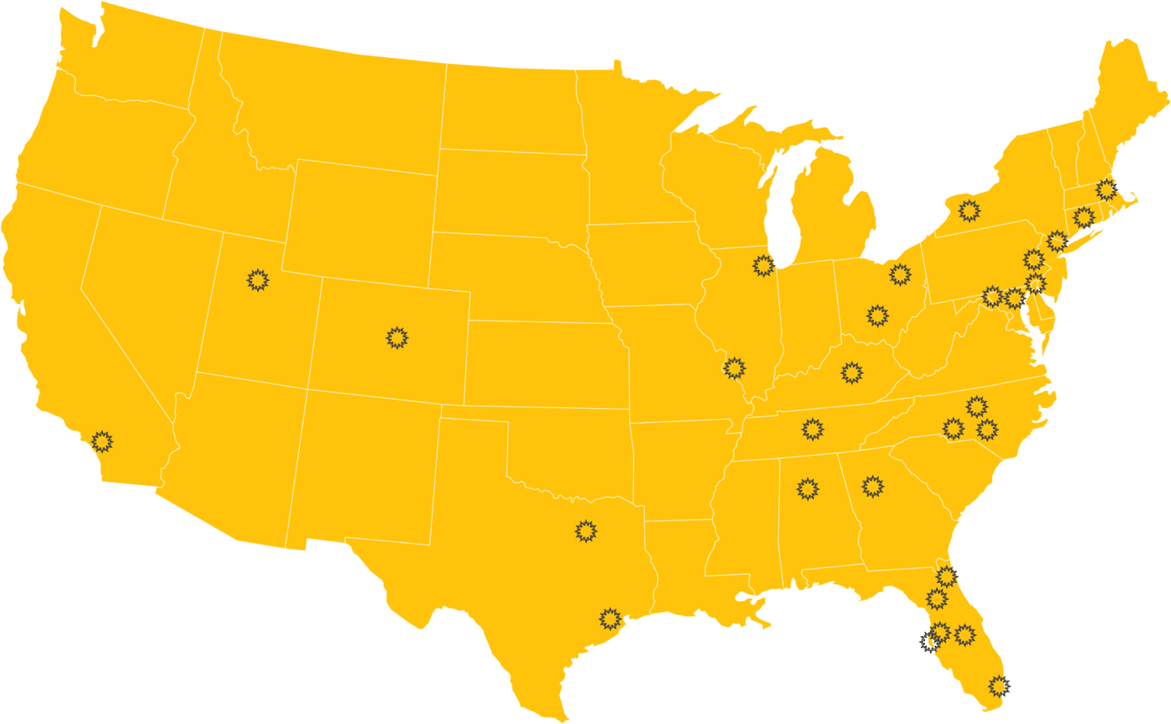
OUR RESEARCH PARTNERS
Nemours/A.I. duPont Hospital for Children-Wilmington, DE
Atrium Health | Levine Cancer Institute-Charlotte, NC
Children's Healthcare of Atlanta-Atlanta, GA
Children's Hospital of Colorado-Aurora, CO
Children's Hospital of Los Angeles-Los Angeles, CA
Children's Hospital of Philadelphia-Philadelphia, PA
Children's National Medical Center-Washington D.C
Cleveland Children's Clinic-Cleveland, OH
Connecticut Children's Medical Center-Hartford, CT
Duke University Health System/ Duke Cancer Institute-Durham, NC
Johns Hopkins All Children's Hospital-St. Petersburg, FL
Johns Hopkins Sidney Kimmel Comprehensive Cancer Center-Baltimore, MD
University of Texas MD Anderson Cancer Center-Houston, TX
Moffitt Cancer Center-Tampa, FL
Montefiore Medical Center-Bronx, NY
Nationwide Children's Hospital-Columbus, OH
Nemours Children's Clinic-Jacksonville, FL
Nemours Children’s Hospital-Orlando, FL
Phoenix Children's Hospital-Phoenix, AZ
Primary Children's Medical Center-Salt Lake City, UT
Rosewell Park Comprehensive Cancer Center-Buffalo, NY
St Joseph's Hospital/Tampa Children's Hospital-Tampa, FL
Children's of Alabama-Birmingham, AL
University of Chicago-Chicago, IL
University of Florida/UF Health Shands Hospital-Gainesville, FL
UK Healthcare | Kentucky Children's Hospital -Lexington, KY
Sylvester Comprehensive Cancer Center*-Miami, FL
UNC Lineberger Comprehensive Cancer Center-Chapel Hill, NC
Children’s Medical Center -Dallas, TX
Vanderbilt-Ingram Cancer Center -Nashville, TN
St Louis Children's Hospital-St. Louis, MO

Slide 4
Top-Rated Charity
We have the highest rankings a charity can receive by Charity Navigator for Financial Health and Accountability & Transparency.
Less than 1% of charities rated earn this score.

Slide 5
DECA is partnering with the National Pediatric Cancer Foundation
YOU are invited to join the challenges set forth by the National Pediatric Cancer Foundation to the members of DECA to create your own Cause Marketing/Fundraising campaign through the DECA Social Impact Challenge and Community Service Project.
Three objectives:
Raise money to support research for a pediatric cancer cure.
Raise awareness about pediatric cancer and the National Pediatric Cancer Foundation’s mission.
Earn Challenge Points

Slide 6
Social Impact Leader of Tomorrow Challenge
Put your entrepreneurial creativity and business knowledge to the test.
Register: www.nationalpcf.org/deca.
Create the next NPCF campaign including:
National Pediatric Cancer Foundation branding
A group fundraising activity
An uplifting, supportive and hopeful message
A social media component
Submit a 3-4 minute video fulfilling DECA evaluation form
1st Place: $2,000 towards expenses for April DECA Conference in Anaheim, CA | 2nd Place: $1,000 towards expenses for April DECA Conference in Anaheim, CA | 3rd Place: $1,000 towards expenses for April DECA Conference in Anaheim, CA
This Photo by Unknown Author is licensed under CC BY-NC

Slide 7
Individual Fundraising Incentives
Raise $43 NPCF DRAWSTRING BAG | Raise $143 NPCF DRAWSTRING BAG and ENAMEL PIN
Raise $430 NPCF DRAWSTRING BAG, ENAMEL PIN and T-SHIRT | Raise $1,430 NPCF DRAWSTRING BAG, ENAMEL PIN, T-SHIRT and HAT

Slide 8
Fundraising Ideas
Ideas
DIY – Create your own fundraiser
Orange-out events, sell “sun” icons, walk around school, fitness challenge, food day, coin collection drive, car wash, auction, etc.
Other fundraising opportunities include…

Slide 9
Example: Rock, Paper, Scissors

Slide 10
Concept: Fitness Funds the Cure- DIY!
Idea=Game
Plan=Process
Fundraising=per play, mulligans, online, etc.
Top Team and Top Individual

Slide 11
Last, but not least… remember to have fun!
You are making a huge impact in the lives of children across the nation that are battling cancer.

Slide 12
NPCF CONTACT
Tawni Morrison
tmorrison@nationalpcf.org (813) 269-0955 (Ext. 493)
Website: NationalPCF.org/DECA

